Slide 1

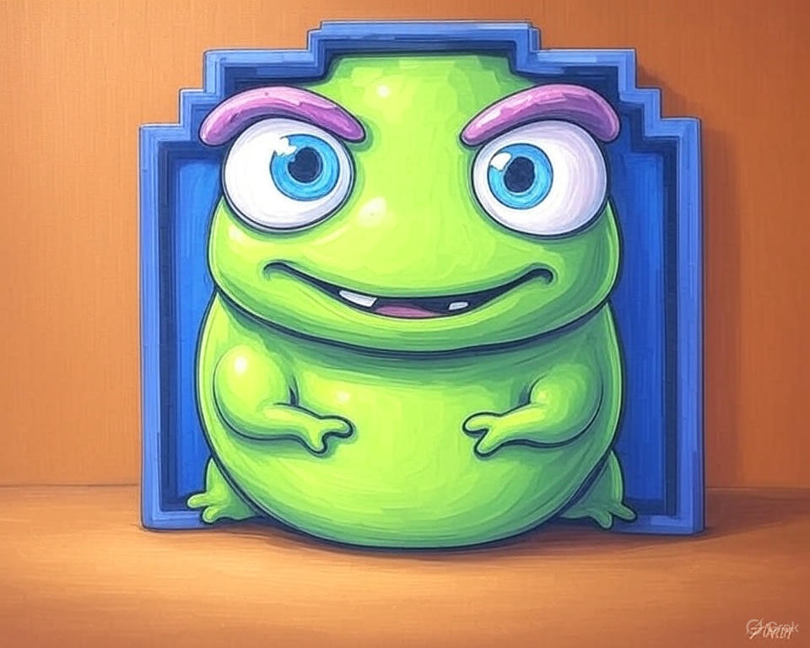

Free
er
“Find your way home”
Murat Guzelocak and Andrias Zelele

Slide 2

Focus Topics:
What inspired us to choose this game as our project?
Structure of our game
Game play
Why should you invest in our game?
Challenges that we faced and solved through the process
Conclusion

Slide 3
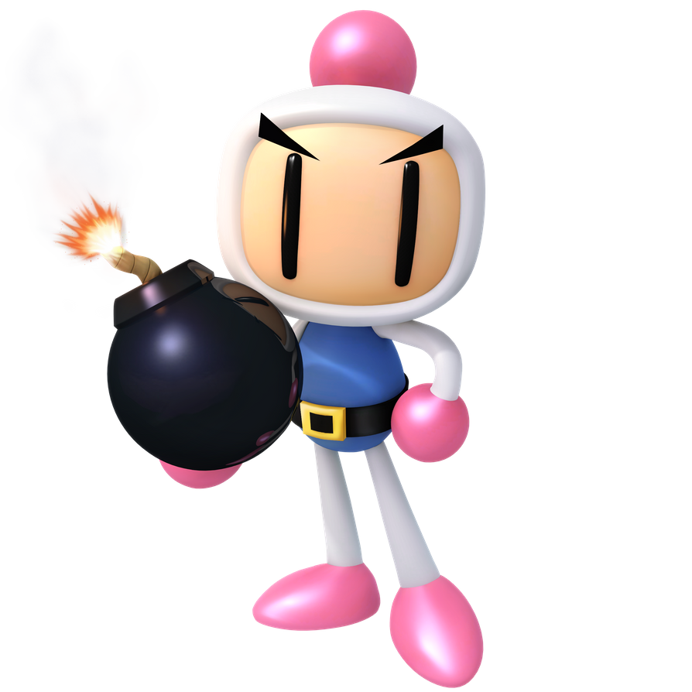
1. What inspired us to choose this game as a project?
This project is inspired by a game called “Bomberman” that was developed in 1983 by Hudson Soft(a Japanese corporation).
Bomberman is a strategic, maze-based computer and video game. Players are put on a stage where they have to destroy Soft Blocks, possibly uncovering items.
New items have been created for different games, while some have been permanent power-ups. Items may be necessary to defeat opponents.
It was commercially successful with over 10 million units of games sold.

Slide 4
FreeBomber:
Based on the Bomberman series games. It is a Java and 2D interactive grid-based environment where players plant bombs to destroy enemies and walls, with the ultimate goal of reaching the exit door.
The game includes:
Multiple levels with increasing difficulty
Dynamic enemies with smart movement (some react to player proximity)
Bomb logic with explosion propagation
cheat-code support
A high score tracking system and user scoreboard
Constraints:
Bombs can be planted only up to a defined limit
Each explosion affects nearby tiles, enemies, and the player.
Enemies move autonomously and check for collision with the environment
The player must navigate to the door after clearing obstructions

Slide 5
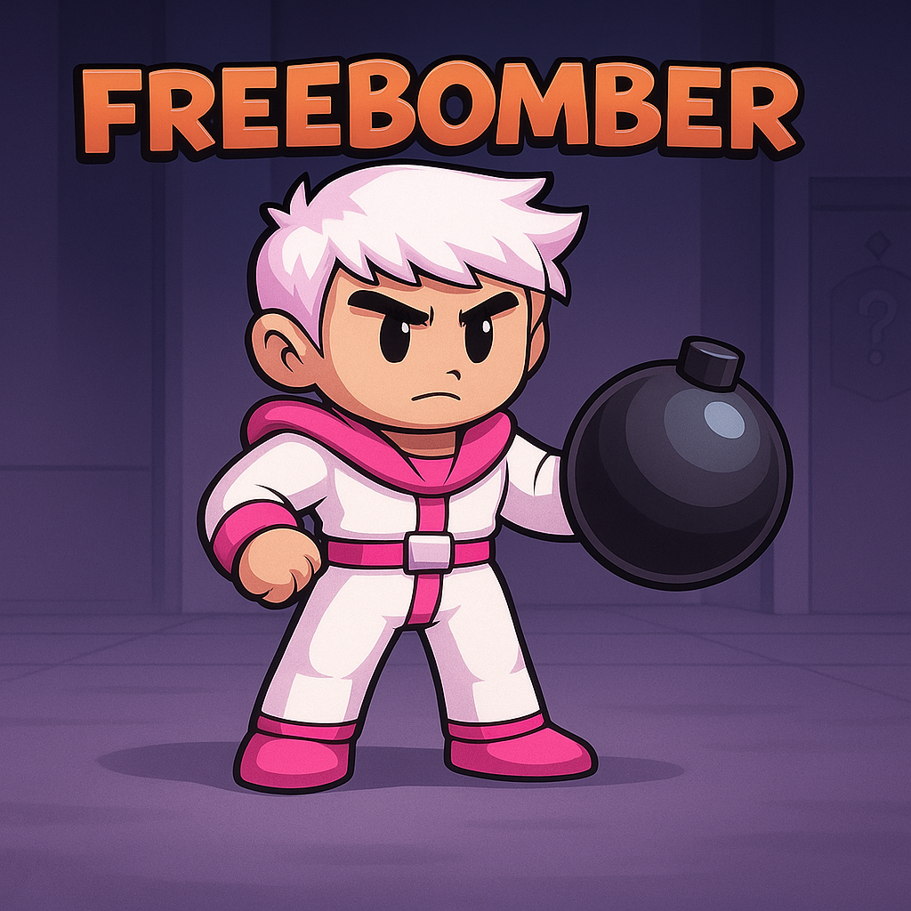
2. Structure of FreeBomber:
FreeBomber game contains: 19 Java classes that communicate with each other, making the game smooth and enjoyable to play.
We are going to talk about the main classes that run the game and mention the helper classes that we created along the way as well.

Slide 6
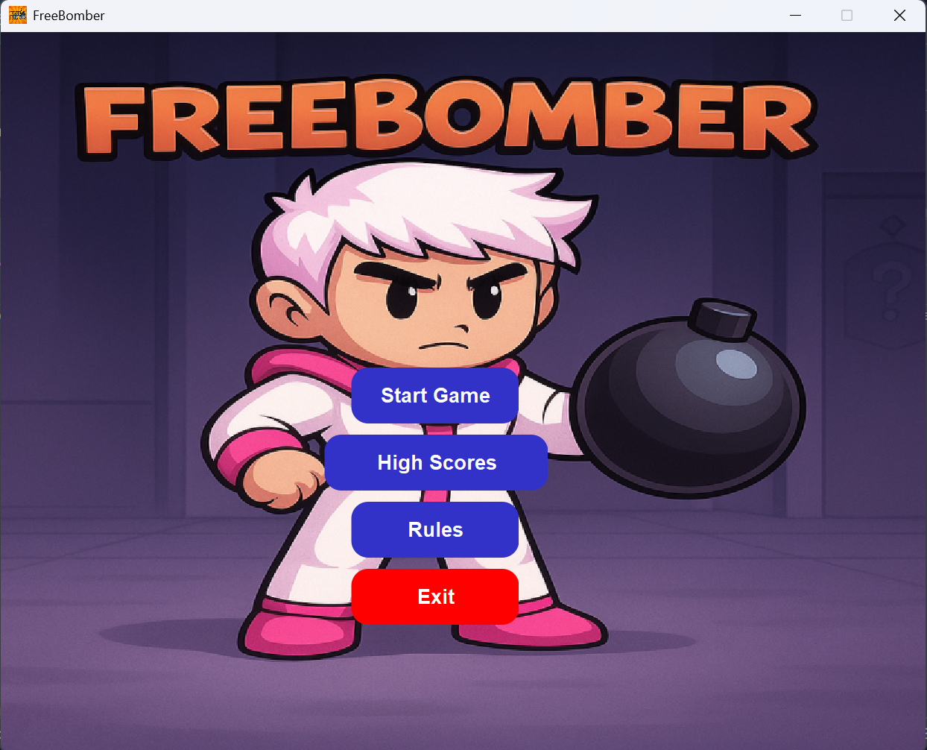
I. FreeBomber.java
The game is executed using a class called “FreeBomber.java”.
This class contains the instance of all panels and classes that come together to make the game playable.
a. MenuPanel.java

Slide 7
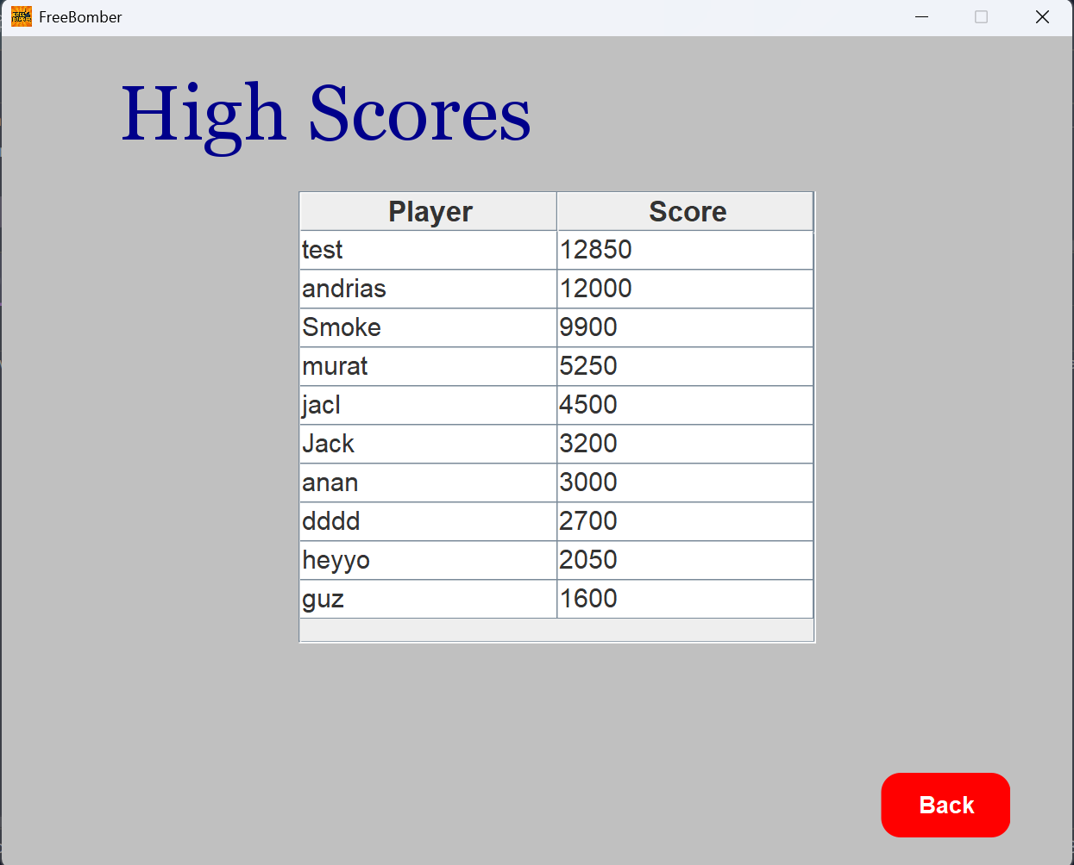
I. FreeBomber.java
The game is executed using a class called “FreeBomber.java”.
This class contains the instance of all panels and classes that come together to make the game playable.
a. HighscorePanel.java

Slide 8
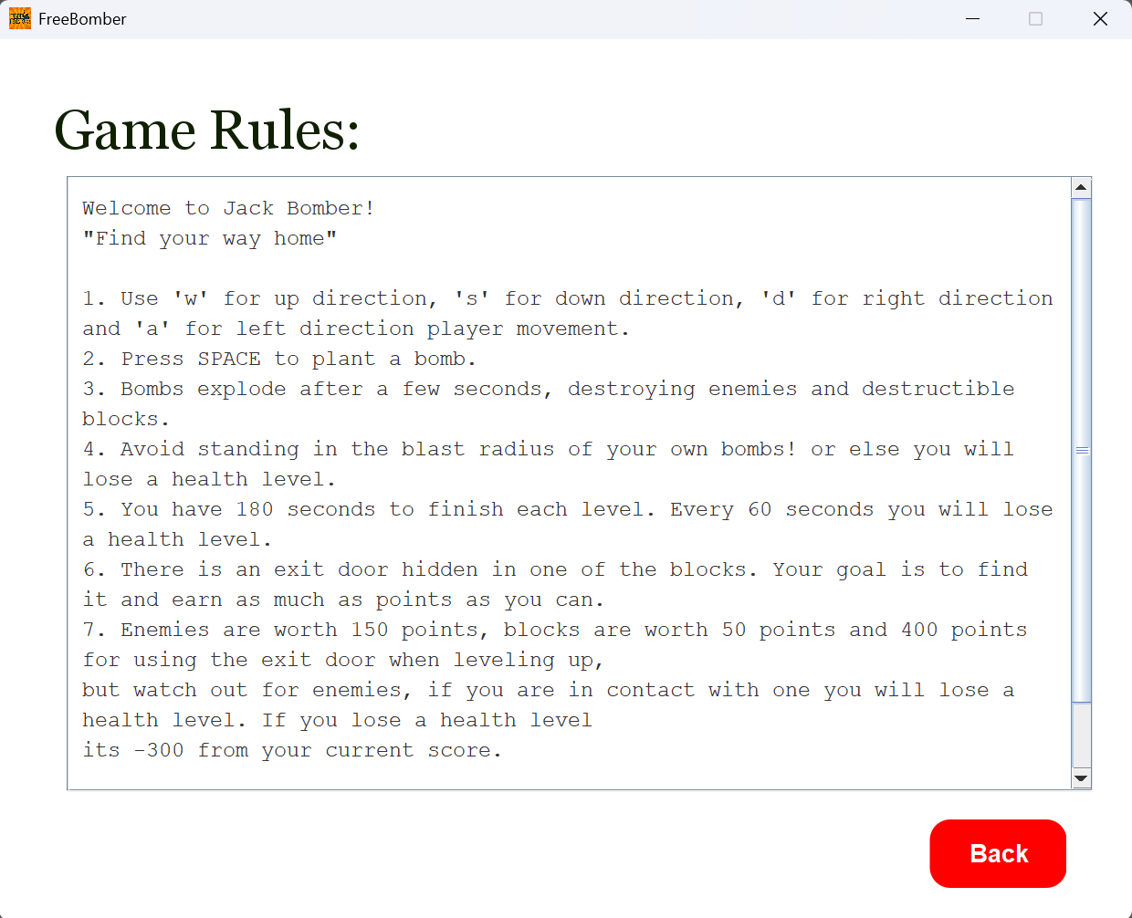
I. FreeBomber.java
The game is executed using a class called “FreeBomber.java”.
This class contains the instance of all panels and classes that come together to make the game playable.
a. RulePanel.java

Slide 9
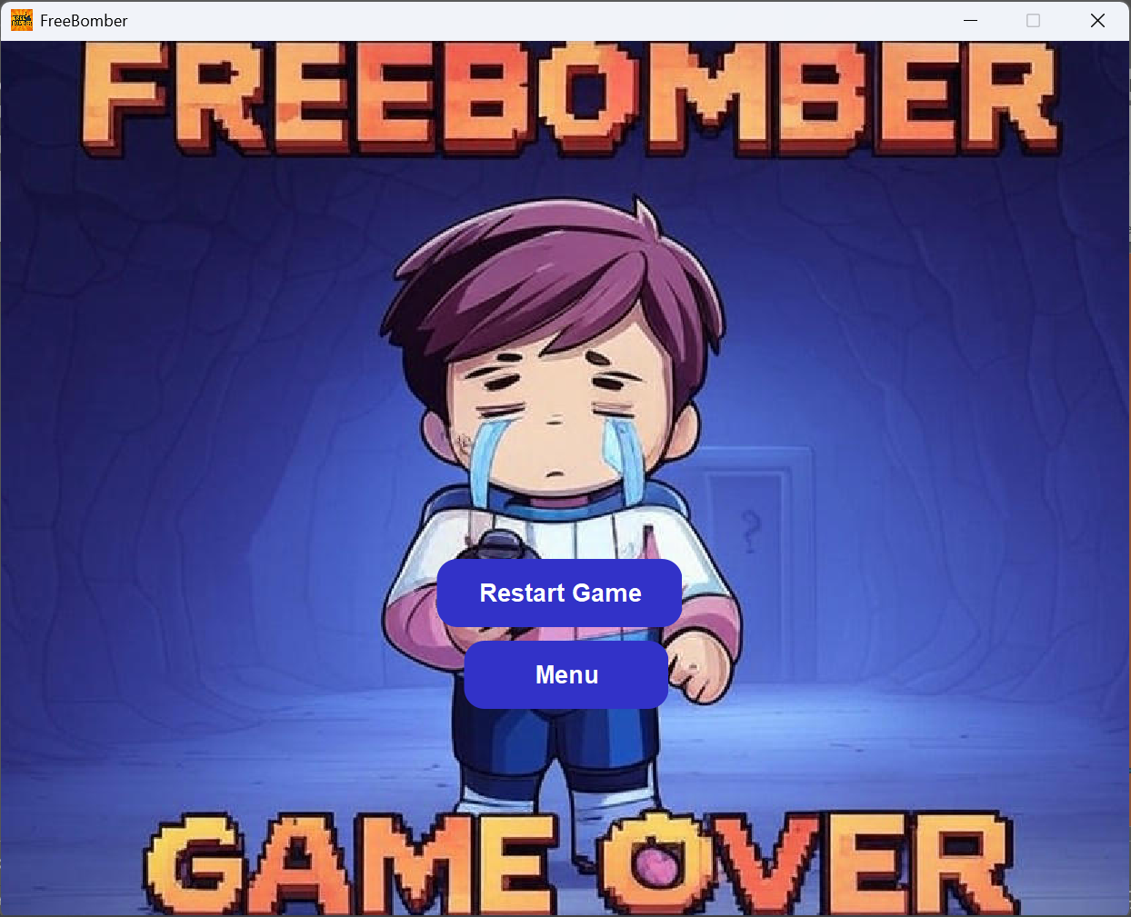
I. FreeBomber.java
The game is executed using a class called “FreeBomber.java”.
This class contains the instance of all panels and classes that come together to make the game playable.
a. GameOverPanel.java

Slide 10
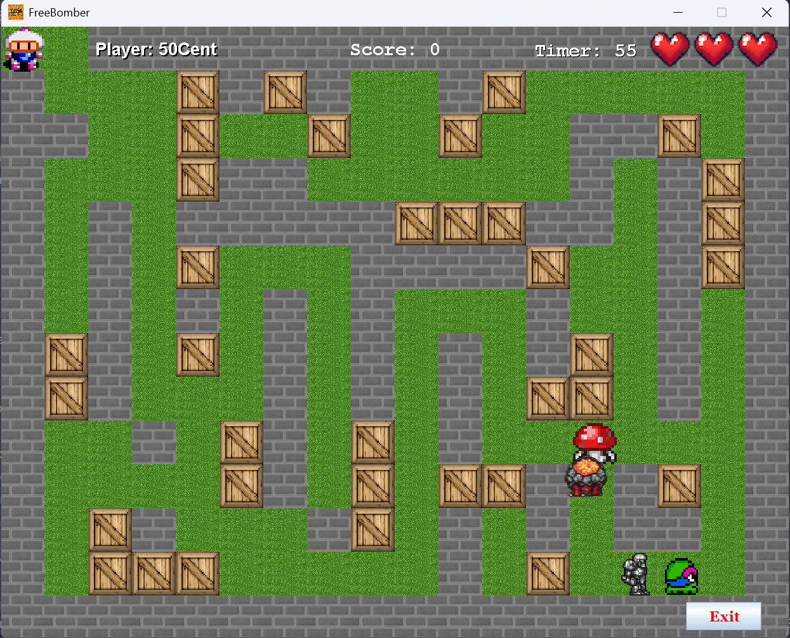
II. BackGround.java
This is a class where the player interacts with the actual map.
This class contains the instances of classes like tile, tile manager, and all the characters in the game.
a. Background.java

Slide 11
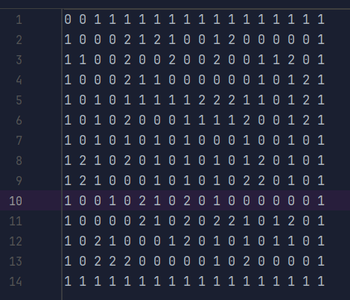



II. BackGround.java
Tile Manager class is the one that is responsible of getting the grid from a text file. Where the Background class uses to draw the game board.
Each map is store in a 2d array of number(0,1, and 2). Making it easy to change and create a different map.
0 =
2 =
1 =
a. TileManager.java

Slide 12
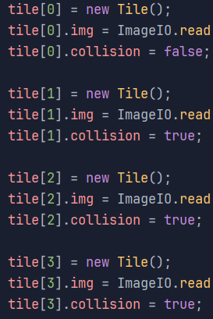
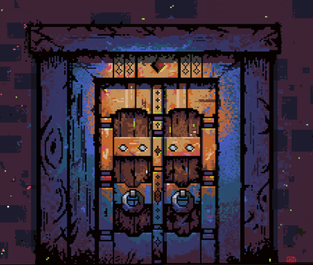
III. CheckCollision.java
Plays a key role in making each character follow only on a grass tile and finding the hidden door.
Every time the game updates by 60 FPS. It retrieves each character’s locations and checks if they are in contact with any of the tiles. If there is a collision, it stops the character from moving in that direction.
If the collision is the exit door, level up.
0 =
2 =
1 =
3 =
a. TileManager.java

Slide 13



IV. Character.java
This class is the backbone for all the characters of the game, including the player and all the enemies.
It carries all shared characteristics of all the characters, like location (x,y), collision, and speed etc.
a. Background.java

Slide 14


V. Bomb.java
This class manages the player’s bomb.
It carries a series of animations of ticking and explosions. Each bomb explodes in 3 seconds.
It calculates its range and collision with any character and blocks for distraction.
a. Background.java

Slide 15
3. Game play
https://drive.google.com/file/d/1WHQPUCaUYlhv10P0em8UPgAOH4-Kfsw9/view?usp=sharing

Slide 16

4. Why should you invest in our game?
Currently, one of the versions of Bomberman (Super Bomberman R) has over 36.7k players with a gross revenue of $348.7k. 19.6% of the players are from the US.
Our game is overall well-structured, user-friendly, and suitable for every age.
This is just a start with a good investment; we can make the game much better and accessible for every platform.

Slide 17
5. Challenges that we faced and solved through the process
Problem: Character movement and animation were not smooth, causing a laggy gameplay experience.
Solution: We optimized the game loop and used a frame-based animation system for fluid movement(threads).
Problem: Bomb placement and explosion timing were inconsistent and hard to manage.
Solution: We created a dedicated Bomb class with an internal count to control behavior precisely.
Problem: Collision detection between JackBomber, bombs, and walls was inaccurate.
Solution: We implemented bounding box collision checks and layered collision maps to improve accuracy.
Problem: Game panels were not communicating with each other.
Solution: We implemented a system of passing variables based on the mainframe.

Slide 18
Conclusion:
It was a good experience for both of us. We learned a lot about being a good teammate and a partner.
It gave us a good understanding of how 2D games work.
The code can be optimized more than it is right now.
“So, give us a hand and let us grow together”.

Slide 19
Thank you

Slide 20
Reference:
https://bomberman.fandom.com/wiki/Bomberman_(series)
https://github.com/andriastheI/FreeBomber
https://gamalytic.com/game/702700

